Slide 1
BOX DRONE
REPRESENT BY
TEAM FURIOUS
SAJID
DEPT OF INFORMATION & COMMUNICATION TECHNOLOGY

Slide 2
What is box drone & why this name is box drone?

Slide 3
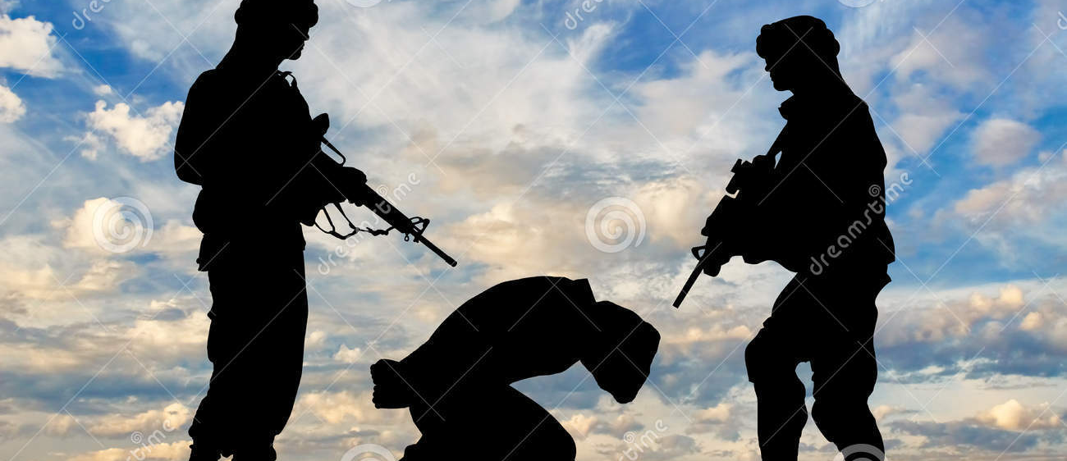

Do you able to indicate this image?
Obviously that is terrorism & hostage.

Slide 4
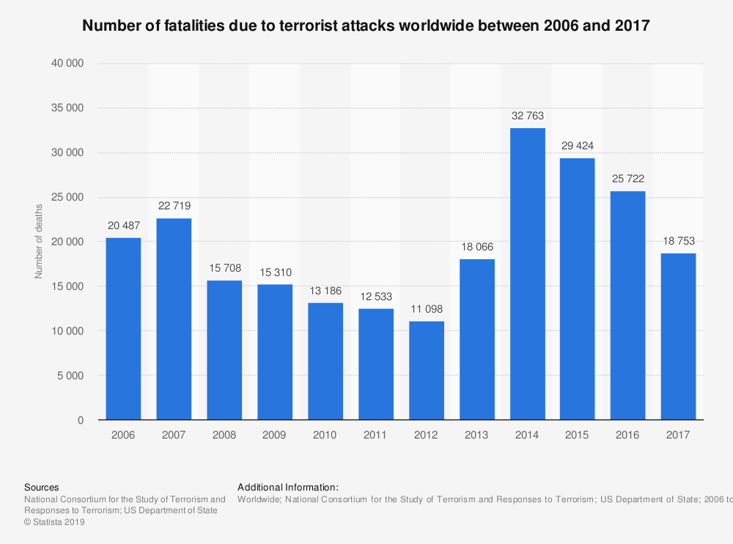

Slide 5
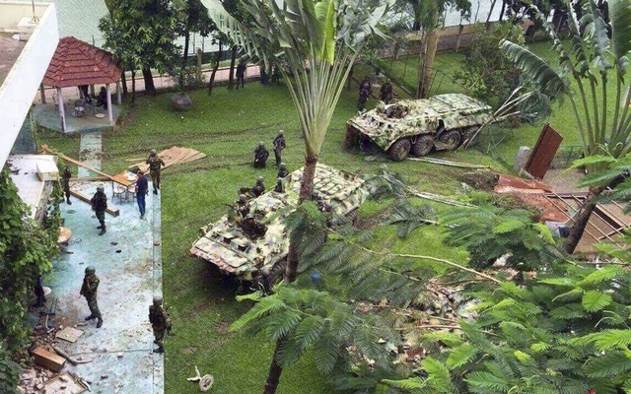
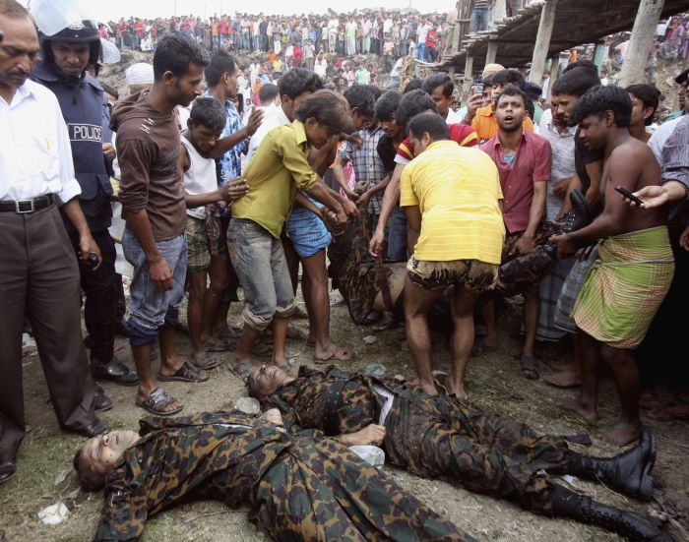
Current solution of terrorism & hostage
Results
Activities

Slide 6
My solution
Use box drone .
And solve the problem of terrorism & hostage without any lose of money or industry or life.

Slide 7
Now we know, what is box drone & why this name is box drone?
Box jellyfisht
Drone
Box drone

Slide 8
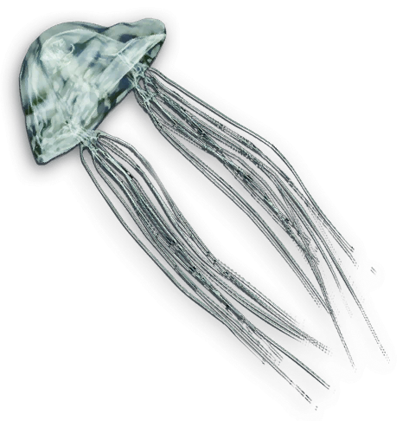
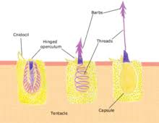
Why is here Box jellyfish?
Box jellyfish can attack the victim by-
Totally invisible way.
Without noise.
So the victim don’t able to realize on attacking moment.

Slide 9
Procedure
Add a string/gun with a simple drone.
Recognize the terrorist and through Sleep drag injection towards him.
Then the terrorist will be senseless.
Make safe the hostage.

Slide 10
Challenges
Recognize the terrorist
Digital image processing
Using transparent material
Make the drone invisible
Reduce the size of drone
Reduce noise
Convent the sound in ultrasonic wave

Slide 11
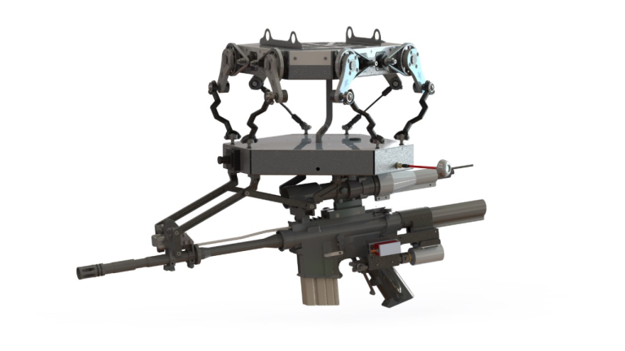

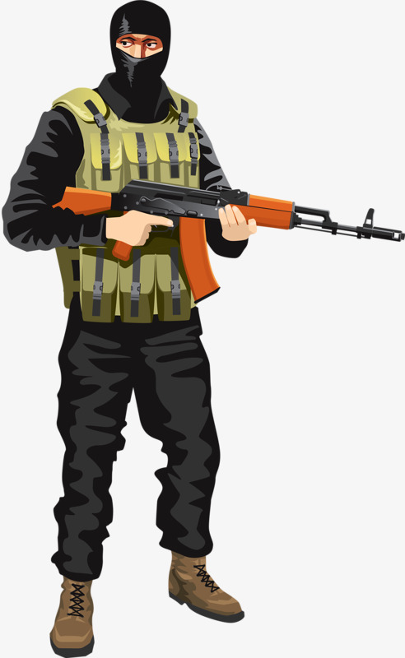
Working model

Slide 12
Advantage
Here is happening no harm to anyone.
The victim will be safe and panic free.
We will get the terrorist alive.

Slide 13
Cost
Current process
My process
At least $50000 per mission.
Holey Artisan Bakery in Gulshan attack, 2 civilians, 5 terrorists, and 2 police officers were confirmed killed, while 50 others, mostly police personnel, were injured.
Only $500.

Slide 14
Query??????

Slide 15
Thank You

